Slide 1

Discrete Mathematics BCSC0010
Module 1
Sets(Lecture1)

Slide 2
Introduction
Discrete mathematics is the study of discrete objects
Discrete means ‘distinct or not connected’
Modern mathematics deals with sets not numbers

Slide 3
Sets
A set is an unordered collection of objects
The objects in a set have similar properties
The objects in a set are called the elements or members of the set

Slide 4
Sets
Lowercase letters are usually used to denote elements of sets
a,b,c,….,x,y,z
Sets are denoted by uppercase letters
A,B,C,…..,X,Y,Z
x ϵ A denotes that ‘x’ is an element of the set A
x ∉ A denotes that ‘x’ is not an element of the set A

Slide 5
Some Standard Sets
N = {1,2,3, ... }, the set of natural numbers
Z = { ... , -2, -1,0, 1,2, ... }, the set of integers
Z+ = {I, 2, 3, ... }, the set of positive integers
Q = {p/q | p ϵ Z, q ϵ Z, and q ≠0}, the set of rational numbers
R= the set of real numbers
C=the set of all complex numbers

Slide 6
Representation of Sets
Roaster or Tabular form
Rule Method or Set Builder form

Slide 7
Roaster or Tabular form
The notation {a, b, c, d} represents the set with the four elements a, b, c, and d
Example:
The set V of all vowels in the English alphabet can be written as
V = {a, e, i, o, u}

Slide 8
Roaster or Tabular form (Examples)
The set O of odd positive integers less than 10 can be expressed by
O= {1, 3, 5, 7, 9}
The set of positive integers less than 100 can be denoted by
{1, 2, 3, ... , 99}

Slide 9
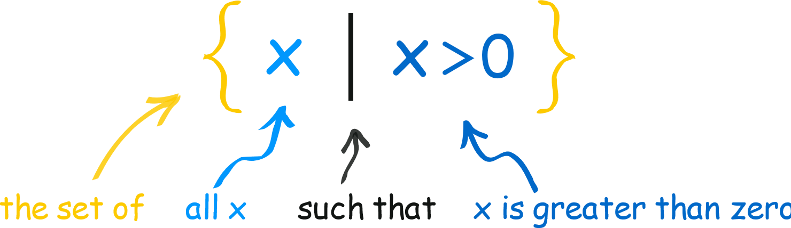
Rule Method or Set Builder form
We can also "build" a set by describing what is in it
It says "the set of all x's, such that x is greater than 0".
In other words any value greater than 0
Sometimes ":" can be used instead of "|", so we can write
{ x : x > 0 }

Slide 10
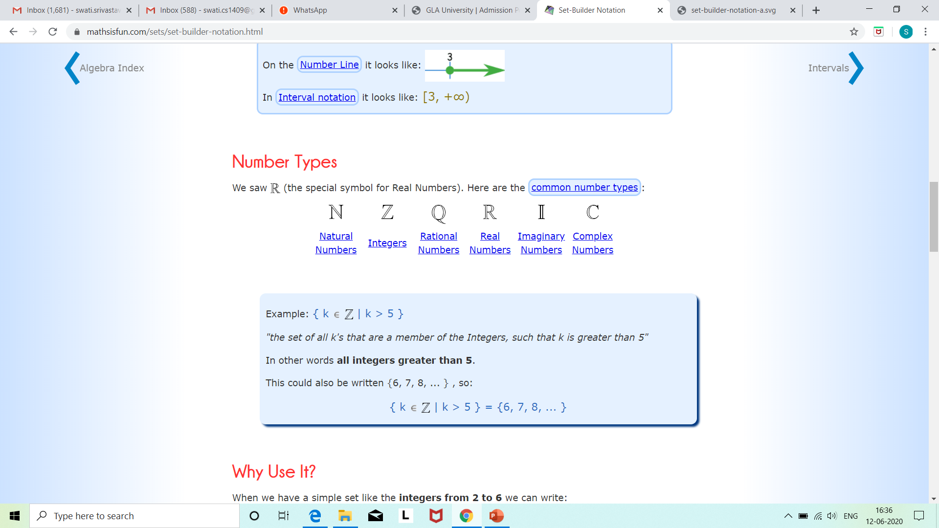
Rule Method or Set Builder form
Ref: https://www.mathsisfun.com/sets/set-builder-notation.html

Slide 11
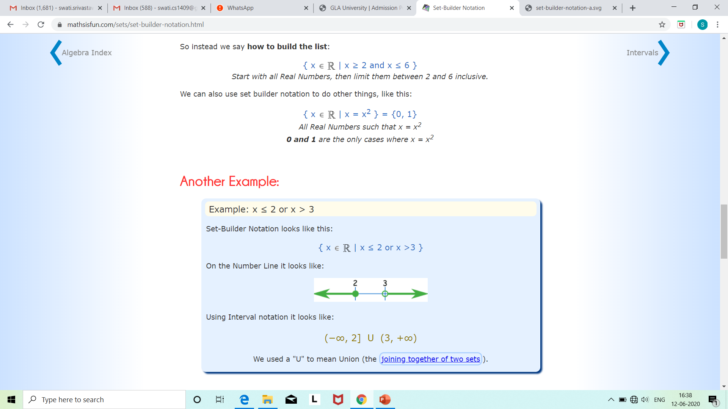
Rule Method or Set Builder form
Ref: https://www.mathsisfun.com/sets/set-builder-notation.html

Slide 12
Types of Set
Finite Set
Infinite Set
Null Set
Singleton Set
Subset
Super Set
Proper Subset
Equal Set
Universal Set
Power Set

Slide 13
Empty Set
A set with no elements is called the null or empty set. It is represented by the symbol { } or Ø .
Examples
the set of months with 32 days
The set of dogs with six legs
The set of squares with 5 sides
The set of cars with 20 doors
The set of integers which are both even and odd

Slide 14
Empty Set (Example)
A={x: x is natural number less than 1}
Since there is no such natural number exists. Thus,
A={} or Ø

Slide 15
Finite Set
Finite sets are the sets having a finite/countable number of elements.
Examples
A set of English alphabets; E={a,b,c,…..,z}
A set of natural numbers less than 6;
A={1,2,3,4,5}

Slide 16
Infinite Set
If the number of elements in a set is not countable/infinite, then it is called an infinite set.
Examples
Set of all natural numbers
{1,2,3,…}
A set of all points on a line
The set of leaves on a tree

Slide 17
Singleton Set
A set which contains only one element is called a singleton set. For example:
B = {x : x is a whole number, x < 1} This set contains only one element 0 and is a singleton set.

Slide 18
Singleton Set
Let A = {x : x ∈ N and x² = 4} Here A is a singleton set because there is only one element 2 whose square is 4.
Let B = {x : x is an even prime number} Here B is a singleton set because there is only one prime number which is even, i.e., 2.

Slide 19
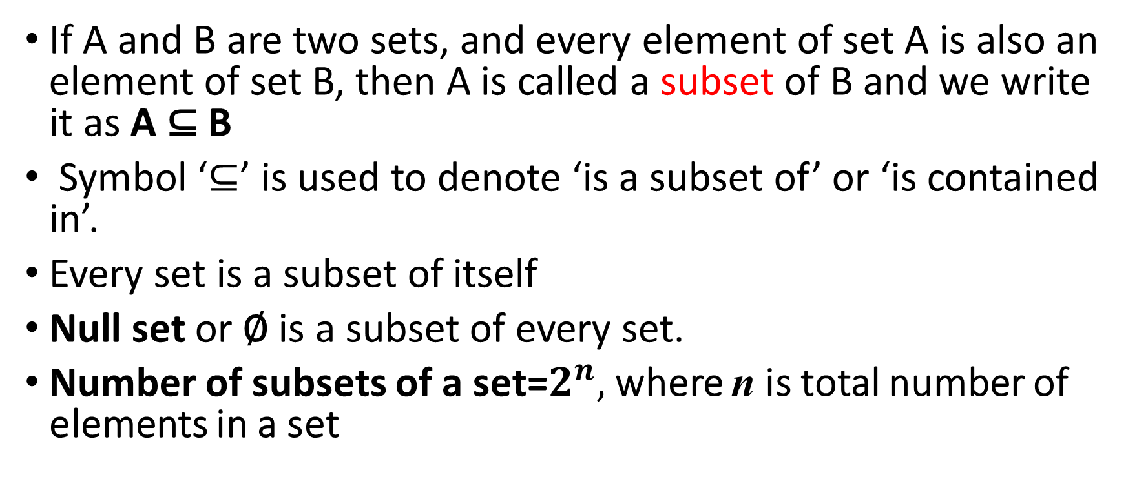
Subset
If A and B are two sets, and every element of set A is also an element of set B, then A is called a subset of B and we write it as A ⊆ B
Symbol ‘⊆’ is used to denote ‘is a subset of’ or ‘is contained in’.
Every set is a subset of itself
Null set or ∅ is a subset of every set.
Number of subsets of a set=$2^{n},$where n is total number of elements in a set

Slide 20
Subset (Examples)
Let A = {2, 4, 6}
B = {6, 4, 8, 2}
Here A is a subset of B, since all the elements of set A are contained in set B.
Vowels in English
Population of Mathura in Uttar Pradesh

Slide 21
Super Set
Whenever a set A is a subset of set B, we say the B is a superset of A and we write, B ⊇ A.
Symbol ⊇ is used to denote ‘is a super set of’
Example
A = {a, e, i, o, u}
B = {a, b, c, ............., z}
Here A ⊆ B i.e., A is a subset of B but B ⊇ A i.e., B is a super set of A

Slide 22
Proper Subset
If A and B are two sets, then A is called the proper subset of B if A ⊆ B but A ≠ B
It is denoted by A ⊂ B
The symbol ‘⊂’ is used to denote proper subset
No set is a proper subset of itself
Null set or ∅ is a proper subset of every set

Slide 23
Proper Subset (Example)
A = {1, 2, 3, 4}
B = {1, 2, 3, 4, 5}
We observe that, all the elements of A are present in B but the element ‘5’ of B is not present in A.
So, we say that A is a proper subset of B.
Symbolically, we write it as A ⊂ B

Slide 24
Equal set
Two sets are equal if and only if they have the same elements
That is, if A and B are sets, then A and B are equal if and only if ∀x(x ϵ A ↔ x ϵ B). It is denoted by A = B.
If A ⊆ B and B ⊆ A then A=B

Slide 25
Equal set (Examples)
The sets {1, 3, 5} and {3, 5, 1} are equal because they have the same elements
Set {1, 3, 3, 3, 5, 5, 5, 5} is same as the set {1, 3, 5} because they have the same elements.
Order of elements is meaningless
It does not matter how often the same element is listed.

Slide 26
Universal Set
A set which contains all the elements of other given sets is called a universal set.
The symbol for denoting a universal set is ∪.
Example:
If A = {1, 2, 3} B = {2, 3, 4} C = {3, 5, 7}
then U = {1, 2, 3, 4, 5, 7} [Here A ⊆ U, B ⊆ U, C ⊆ U and U ⊇ A, U ⊇ B, U ⊇ C]

Slide 27
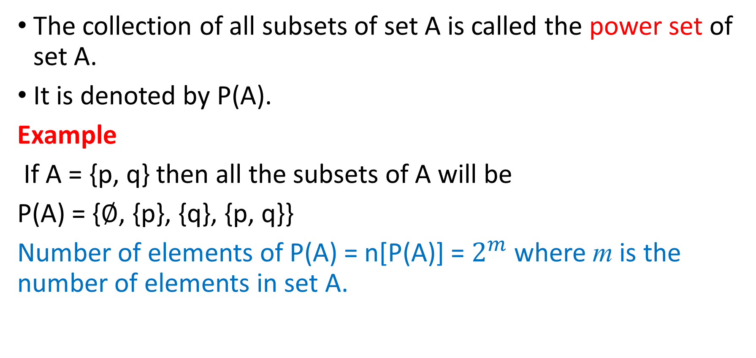
Power Set
The collection of all subsets of set A is called the power set of set A.
It is denoted by P(A).
Example
If A = {p, q} then all the subsets of A will be
P(A) = {∅, {p}, {q}, {p, q}}
Number of elements of P(A) = n[P(A)] = $2^{m}$ where m is the number of elements in set A.

Slide 28
Find the power set of {0,1,2} set
Solution:
The power set P({0, I, 2}) is the set of all subsets of
{0, 1, 2}. Hence,
P({0,1,2})={Φ,{0},{1},{2},{0,1},{0,2},{1,2},{0,1,2}}
Note that the empty set and the set itself are members of this set of subsets.

Slide 29
Cardinality of a Set
Cardinality of a set S, denoted by |S| is the number of elements of the set. The number is also referred as the cardinal number. If a set has an infinite number of elements, its cardinality is ∞.
Example −
| {1,4,3,5} | = 4,
| {1,2,3,4,5,…} | = ∞

Slide 30
In next lecture we will discuss…
Operations on sets

